Slide 1
JavaScript Capstone Project
By: Diana

Slide 2
TABLE OF CONTENTS
01
02
SDLC Implementation
Jira
03
04
Design Algorithm
Product
The Software
Development Cycle
A way to track all the activities for your project
Show through
pseudocode
Here is the finished
product

Slide 3
01
SDLC Implementation
The Software Development Lifecycle

Slide 4
The Software Development Cycle
Planning
Analysis
Design
Implementation
Testing & Integration
Maintenance
Plan the user interface and overall structure
Break down the features into smaller task
Design the user interface (consider user experience)
Write the HTML, CSS and javascript code
Identify and fix any bugs or issues
The code is up to date,
Minimal updates needed

Slide 5
02
Jira
A way to make projects easier to manage

Slide 6
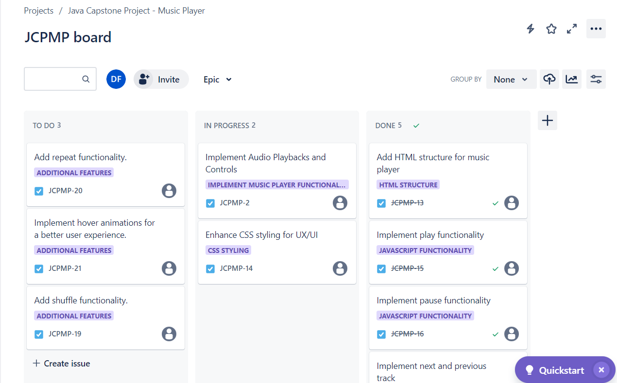
Jira
C
D
E
F
G
A
B

Slide 7
03
Design Algorithm
Pseudocode time

Slide 8
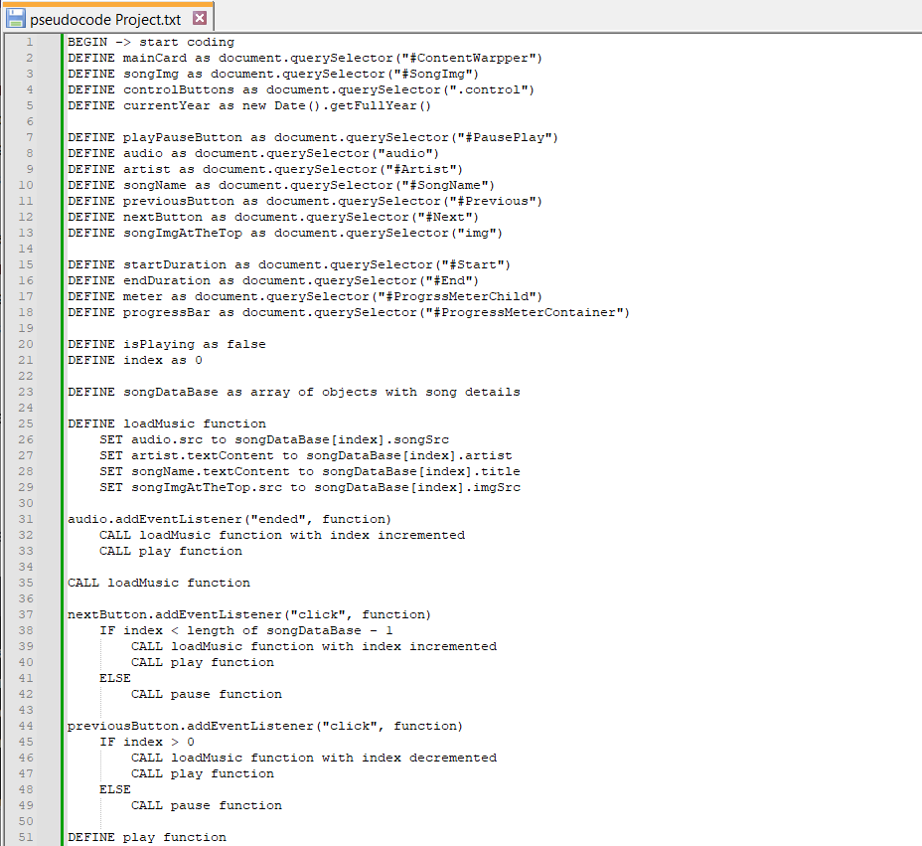
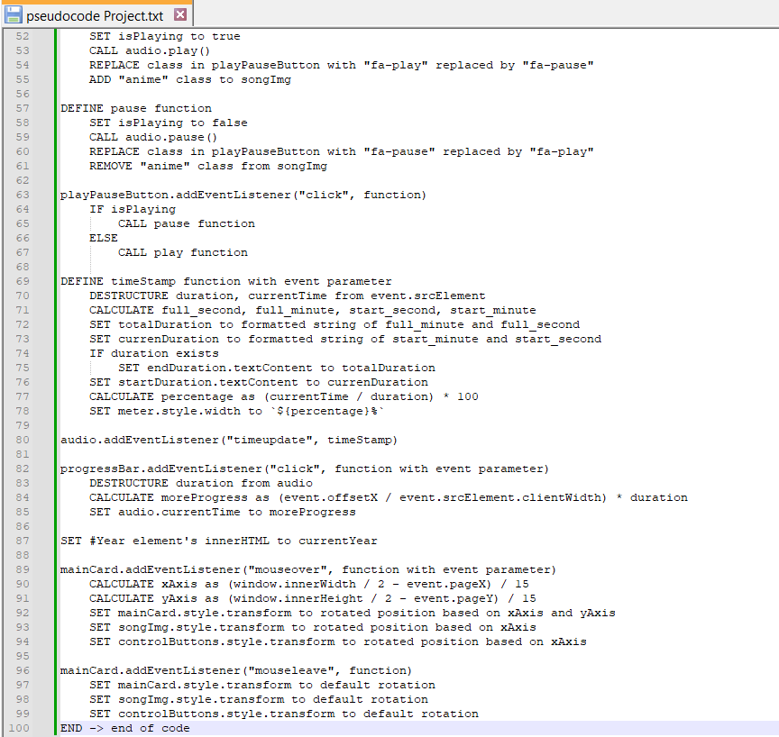

Slide 9
04
Product
Check my product

Slide 10

Product

